Slide 1
Overview of the Drainage Design Process and Redesign of the Drainage Folder

Slide 2
Agenda
Drainage design process
  From preliminary line and grade to letting
Drainage folder redesign
  conceptual, not ready to implement
  Lightened folder requirements
  New source file submittal format

Slide 3
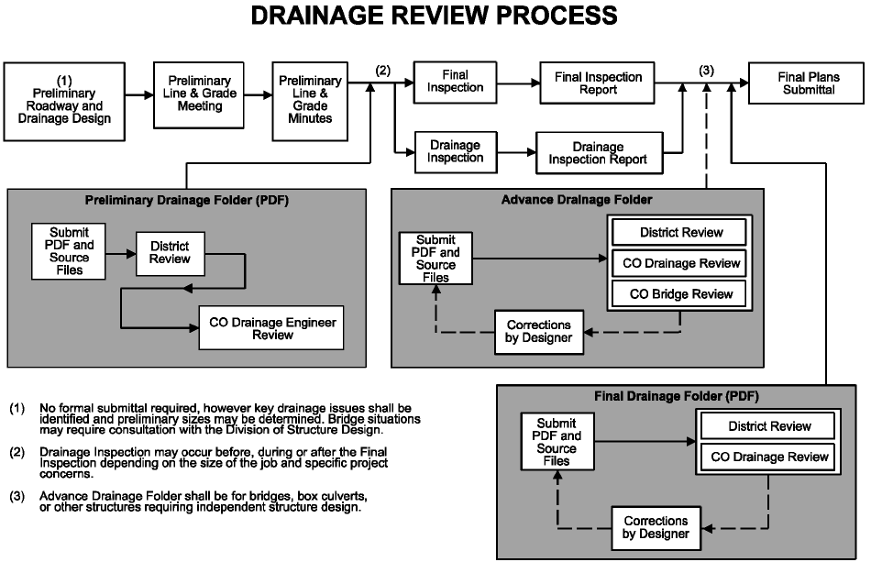

Slide 4
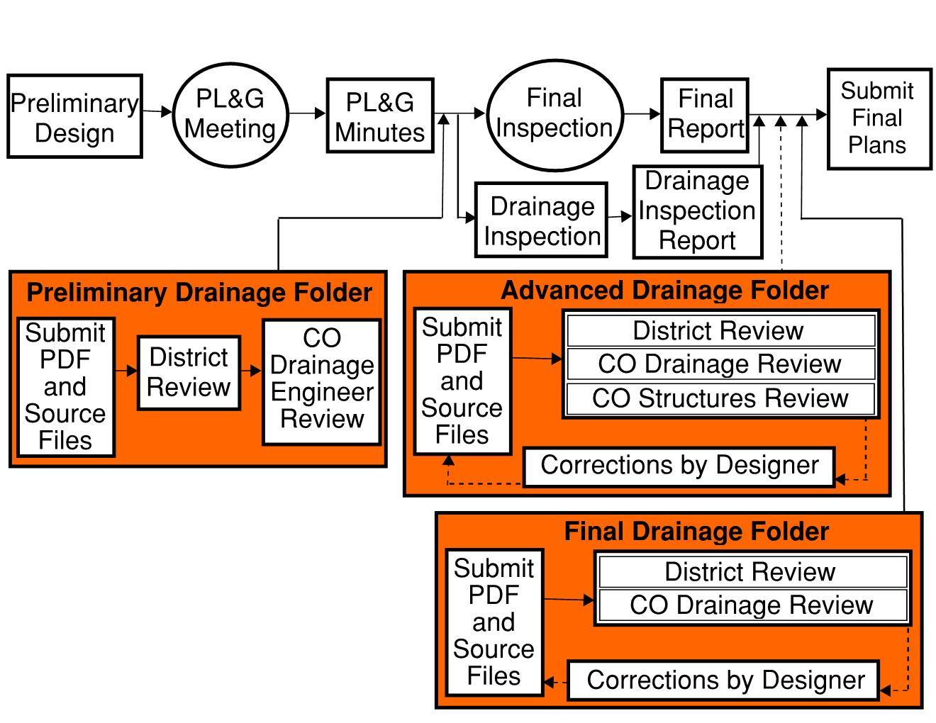

Slide 6
Avoidance of FEMA SFHA, karst, streams, impoundments
  Minimize or mitigate if unavoidable
Impacts to sensitive drainage areas/structures
MS4 considerations

Slide 8
Pl&G Minutes should include a tentative list of drainage structures impacted by the selected alternative

Slide 9

submitted at least 2 weeks prior to the final inspection or stand-alone drainage inspection
Submitted to the PM, then PM places in projectwise and notifies the Drainage branch
the drainage engineer will document receipt with an email to the pM and a stamp on the folder in projectwise

Slide 10
submitted at least 2 weeks prior to the final inspection or stand-alone drainage inspection
Submitted to the PM, then PM places in projectwise and notifies the Drainage branch
the drainage engineer will document receipt with an email to the pM and a stamp on the folder in projectwise

Slide 11
submitted at least 2 weeks prior to the final inspection or stand-alone drainage inspection
Submitted to the PM, then PM places in projectwise and notifies the Drainage branch
the drainage engineer will document receipt with an email to the pM and a stamp on the folder in projectwise

Slide 12
submitted at least 2 weeks prior to the final inspection or stand-alone drainage inspection
Submitted to the PM, then PM places in projectwise and notifies the Drainage branch
the drainage engineer will document receipt with an email to the pM and a stamp on the folder in projectwise

Slide 13


Slide 14
Comments and recommendations of proposed drainage design are discussed by the project team
Input from other project team members is taken into account
Draft inspection minutes are distributed for comments

Slide 16
Preliminary design modifications
final inspection minutes are finalized after consensus is met
the drainage engineer will then document completion of review with an email to the project manager and a stamp on the folder in projectwise
Comments/recommendations from final inspection minutes are incorporated into drainage design

Slide 19
ADVANCED situation FOLDER
“order form” from Project manager to structural design
content established by the Division of Structural design
should reflect Applicable final inspection comments
Submitted to the PM, then PM places in projectwise and notifies the Drainage branch

Slide 23
ADVANCED situation FOLDER
the drainage engineer will document receipt with email to the project manager and a stamp on the folder in projectwise
Submits comments and works with structural designer to resolve any issues
the drainage engineer will document completion of review with an email and a stamp on the folder in projectwise

Slide 24
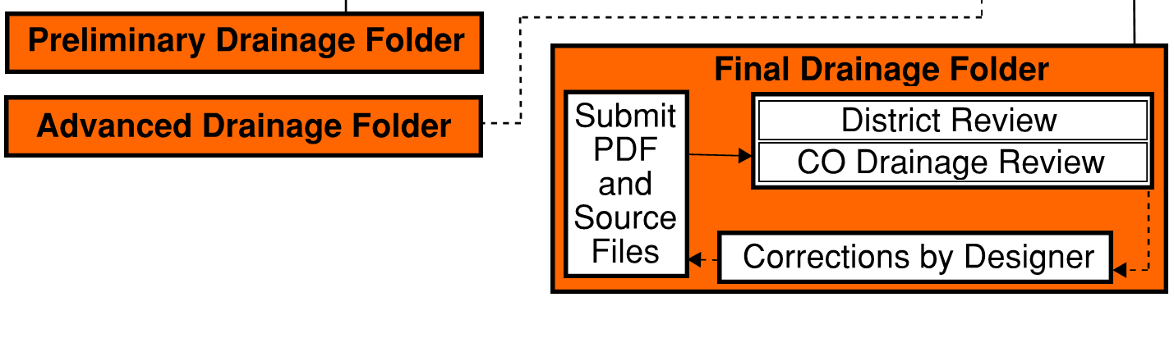

Slide 26
FINAL DRAINAGE FOLDER
the legal document archived for project drainage design
submitted at least 2 weeks prior to submittal of final plans
Submitted to the PM, then PM places in projectwise and notifies the Drainage branch
the drainage engineer will document receipt with an email and a stamp on the folder in projectwise

Slide 30
FINAL DRAINAGE FOLDER
Drainage engineer confirms all comments from review process were addressed
  If not, works with designer to resolve any issues
the drainage engineer will document completion of review with an email and a stamp on the folder in projectwise

Slide 31
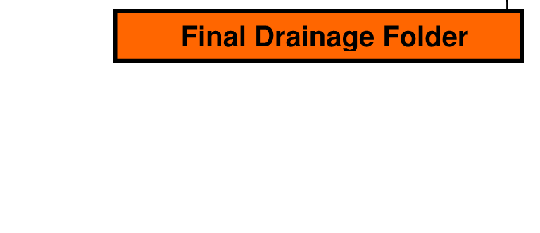

Slide 32
Drainage design Do’s and don’ts
Do
Review fema maps during pl&g
Be aware of fema regulations (clomr, lomr, and no-rise)
Consult the drainage office for best modeling practices
Provide adequate time for drainage review
Review the drainage manual
Analyze existing hydraulic conditions
Submit source data with all drainage folders

Slide 33
Drainage design Do’s and don’ts
Don't
Significantly change the quality or quantity of flow that discharges off of kytc right-of-way
Submit preliminary/final folders the day before or after the final inspection/letting without prior approval
Deviate from the drainage manual guidance without documentation or consultation with the drainage branch
Submit a folder without source files

Slide 34

Drainage Folder

Slide 35
New drainage documentation
Tiered structure convention
folder format and requirements
Pipe sheet requirements
Pipe drainage summary sheet requirements
source file submission format

Slide 36
Drainage Structure Tiers
Tier 1 - structures must meet all of the following criteria:
  Cross drains with a diameter (or equivalent) of 24” or less
  Fill height < 5’ (for maintenance reasons)
  ADT < 1500
Tier 2 - structures must meet one of the following criteria:
  Storm sewers
  Cross drains that do not fall into Tier 1 or Tier 3
Tier 3 - structures must meet one of the following criteria:
  any structure with a diameter (or equivalent) ≥ 54”
  any structure that requires a HEC-RAS or other advanced analysis

Slide 37
folder format and requirements
Projects containing only tier 1 structures
  no drainage folder or source files
  A cover sheet will be required for archival purposes
  New pipe sheets and pipe drainage summary sheet still required in plans

Slide 38
folder format and requirements
Projects containing at least one tier 2 or tier 3 structure
  folder and source files for all structures
  Folder format
    Section 1 – Drainage summary
    Section 2 – culverts
    Section 3 – storm sewers
    Section 4 – advanced analysis (only for tier 3 structures)
    Section 5 – entrance pipes

Slide 39
Items No longer required
Project location map
Design executive summary
Project level hydrology (still in source files)
Abbreviated plan set
Drainage design summary form (TC 61-100)
Culvert site layout
Computer outputs (in source files)
Storm sewer system summary form (TC 61-517)
Pavement inlet spread calculations (in source files)
Channel calculations (in source files)

Slide 40
Section 1 – Drainage summary
Drainage Structure Summary (similar to TC 61-504)
Project Correspondence
  Will include all pertinent meeting minutes, email chains, etc.
Hydrologic and Hydraulic Discussion
  The discussion should cover the following:
    Site conditions
    Design assumptions
    Analysis methodology
    programs used
    Deviation from Drainage Manual guidance

Slide 41
Drainage Structure Summary (TC 61-504)

Slide 42
Section 2 – culverts
Pipe Sheets
  Pipe sheets will contain more information than currently required. The new information will be:
    - Design and Check Q
    - Design and Check HW
    - Design outlet Velocity
    - Allowable HW and justification
    - Drainage Area
    - Tailwater geometry
PLAN VIEW OF 100 YEAR HEADWATER EXTENT

Slide 43
New pipe sheets

Slide 44
New pipe sheets
NEW FLOOD DATA TABLE
OLD FLOOD DATA TABLE
FLOOD EVALUATION DATA DRAINAGE AREA = XXX.X ACRES
 | RETURN INTERVAL (YR) | RUNOFF (CFS) | HEADWATER ELEVATION (FT) | OUTLET VELOCITY (FPS)
DESIGN | 25 | -- | -- | --
CHECK | 100 | -- | -- | --
ALLOWABLE HEADWATER (FT) = --
BASIS FOR AHW | DESIGNER DESCRIBES ESTABLISHMENT OF ALLOWABLE HEADWATER ELEVATION EX: LOW SHOULDER ELEVATION = XXX.XX FT
FLOOD DATA
 | STORM (YR) | RUNOFF (CFS) | HEADWATER ELEV. (FT)
DESIGN CHECK | 25 100 | XXX.X XXX.X | XXX.XX XXX.XX

Slide 45
New pipe sheets
PLOT DESIGN/CHECK HW
TAILWATER GEOMETRY TABLE
TAILWATER GEOMETRY
SLOPE = X.XX%
D = XX FT
T = XX FT
Z = X
TW Control =

Slide 46
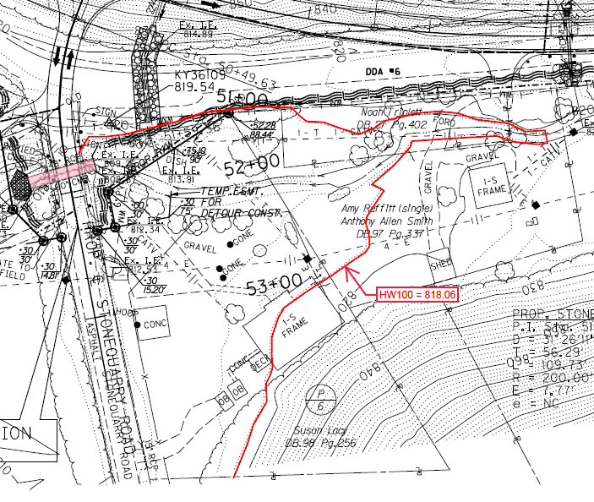
100 year Headwater

Slide 47
Section 3 – storm sewers
Each storm sewer network will require:
  Plan sheet with network identified
  Pipe sheets (same format as for culverts)
  HGL/EGL plot

Slide 48
Section 4 – advanced analysis
(required for tier 3 structures, used for other structures when deemed necessary)
a site specific discussion (should discuss items outside the scope of the general Hydrologic and Hydraulic Discussion from Section 1)
  site conditions
  design considerations
  Assumptions
  program used
report of results
  refer to the Drainage Manual

Slide 49
Section 5 – Entrance Pipe
This section should include the Entrance Pipe summary sheet

Slide 50
source file submission
Electronic Source files
  Microstation files
  Hydrology
  hydraulics

Slide 51
source file submission
Microstation files
  *.KMZ File of Alignment
  *.alg file
  *.dtm file
  *.dgn file

Slide 52
source file submission
Hydrology
  NOAA Intensities Table
  Watershed maps for pipes
    map files
    longest flow path
    C value calculations
  Watershed maps for ditches
    map files
    longest flow path
    C value calculations

Slide 53
source file submission
Hydraulics
  Culverts
    flow calculation files
    HY8 files (single file for each crossing containing existing, proposed, and alternative materials)
  Storm Sewers
    flow calculation files
    HW calculations for headwalls and grates
    Program files (e.g.: StormCAD)
    Spread calculations (could be included in program file or standalone worksheet)

Slide 54
source file submission
Hydraulics (continued)
  Ditches
    Ditch lining design files or charts used
    Advanced Analysis
    Program files (HEC-RAS, SRH-2D, HEC-HMS, etc)
  Entrance Pipes
    HY8 files

Slide 55
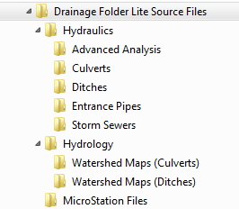
source file submission format

Slide 56

Questions?

